Slide 1

Detectra Platform Bot Review & Campaign Intelligence
End-to-End MLOps Workflow for E-commerce Trust

Slide 2
The Threat: Bot & Campaign Attacks
01
Erosion of Platform Trust
Automated bot networks flood listings with highly realistic fraudulent ratings, immediately destroying the integrity and customer reliability of e-commerce ratings.
The Coordinated Trust Crisis
"Highly Synchronized. Completely Devastating."
Bad actors no longer rely on single, isolated fake accounts. Instead, they deploy highly synchronized botnets that mimic genuine user patterns, rendering classic filters completely obsolete.
02
Coordinated Rating Manipulation
Competitors and organized groups schedule localized attack spikes, exploiting regional release windows to synthetically boost or suppress target products.
03
Extreme Operational Drain
Handling continuous high-velocity bot traffic severely burdens engineering pipelines, spikes cloud infrastructure costs, and overwhelms manual support teams.
Notes:
Why standard moderation fails against modern fraud.
“Imagine ten different accounts posting convincing five-star reviews for the same product within twenty minutes. Each review may look genuine when inspected alone. But together, their timing, wording and behavior reveal coordination. That is the trust problem Detectra addresses. Traditional review classifiers mainly ask, ‘Does this sentence look fake?’ Detectra asks a second and more important question: ‘Are multiple accounts acting together as a campaign?’ This matters because coordinated manipulation can distort product ratings, damage customer trust and overwhelm human moderators.”

Slide 3

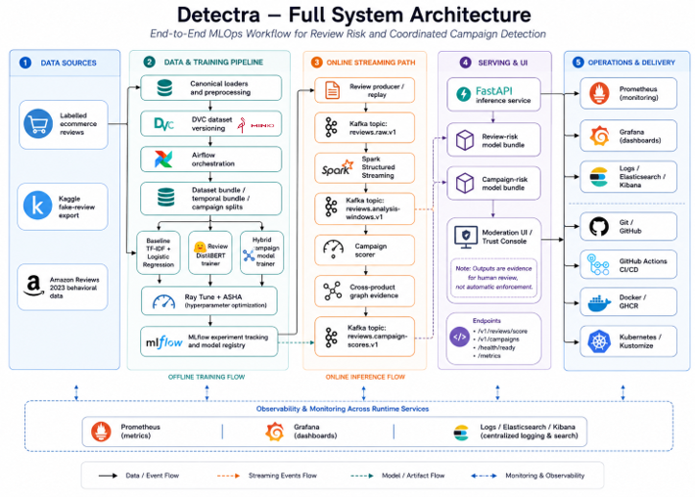
Architecture Overview
Detectra separates individual review-risk estimation from coordinated campaign-risk detection through a complete MLOps lifecycle:
Offline Training: DVC, Airflow, and Ray Tune for model building.
Online Streaming: Kafka and Spark for real-time event windowing.
Serving & UI: FastAPI backends driving human-in-the-loop moderation.
Ops & Delivery: Full observability, logging, and automated CI/CD pipelines.
Notes:
“Detectra the platform we built is focused on separating and addressing the problem into two levels. This is our complete architecture. First, an individual review-risk model uses DistilBERT to understand the meaning of one review. Second, a hybrid campaign model combines semantic similarity with temporal and behavioral signals to detect groups acting together. Around those models, we built an end-to-end MLOps lifecycle: DVC versions the data, Airflow orchestrates bounded jobs, Ray Tune searches model configurations, and MLflow records experiments. For online processing, Kafka transports events, and Spark creates event-time analysis windows. FastAPI then serves the result to a human moderator. Finally this entire platform results can be modelled and logged using Grafana and Kibana, along with promethue sand elasticsearch in the backed. The key design principle is separation of responsibility: every tool solves one clear part of the lifecycle.”

Slide 4
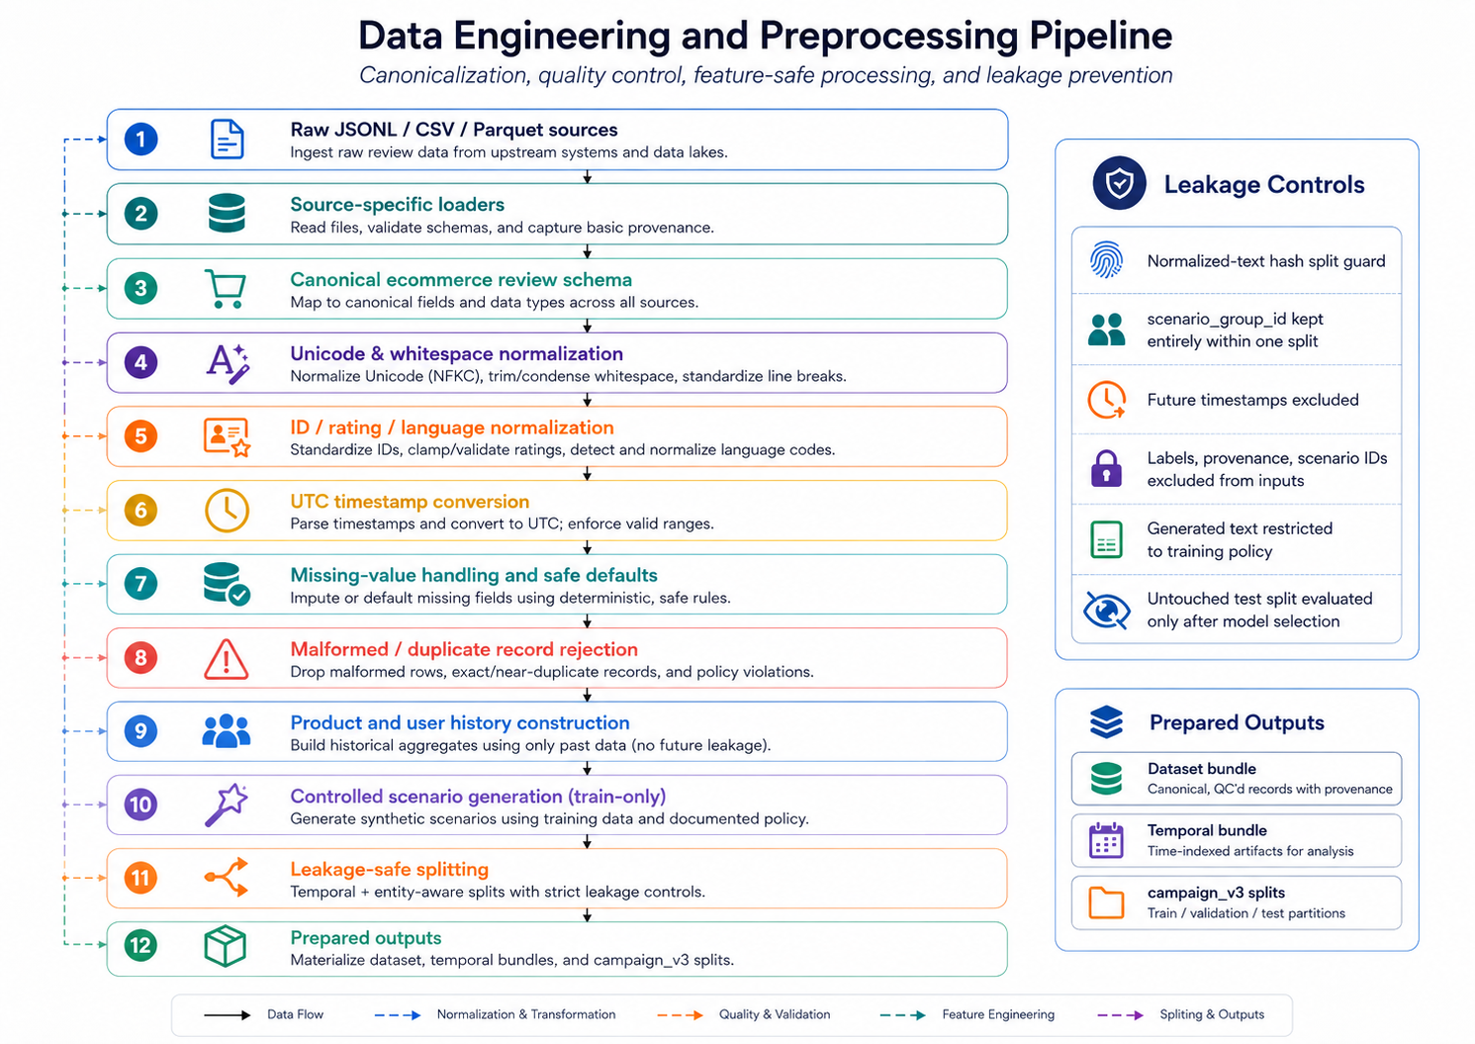
Data Engineering Pipeline
Raw reviews undergo strict canonicalization and quality control to prevent data leakage and ensure safe features:
Normalization: Standardizes UTC timestamps, language codes, and Unicode text.
Leakage Prevention: Future timestamps and untrusted labels are rigorously excluded.
Controlled Scenarios: Synthesizes realistic benign and campaign profiles for robust training.
Notes:
“Raw reviews are canonicalized into one consistent schema. We normalize Unicode text, language values and timestamps, validate ratings and remove unsafe future information. Most source review records are directly pulled from the Amazon review datasets. Coordinated campaign examples are deliberately synthesized because reliable campaign-level ground truth is limited. These scenarios alter controlled behavioral fields while preserving provenance, and time-based splits prevent future examples from leaking into earlier training data.”

Slide 5
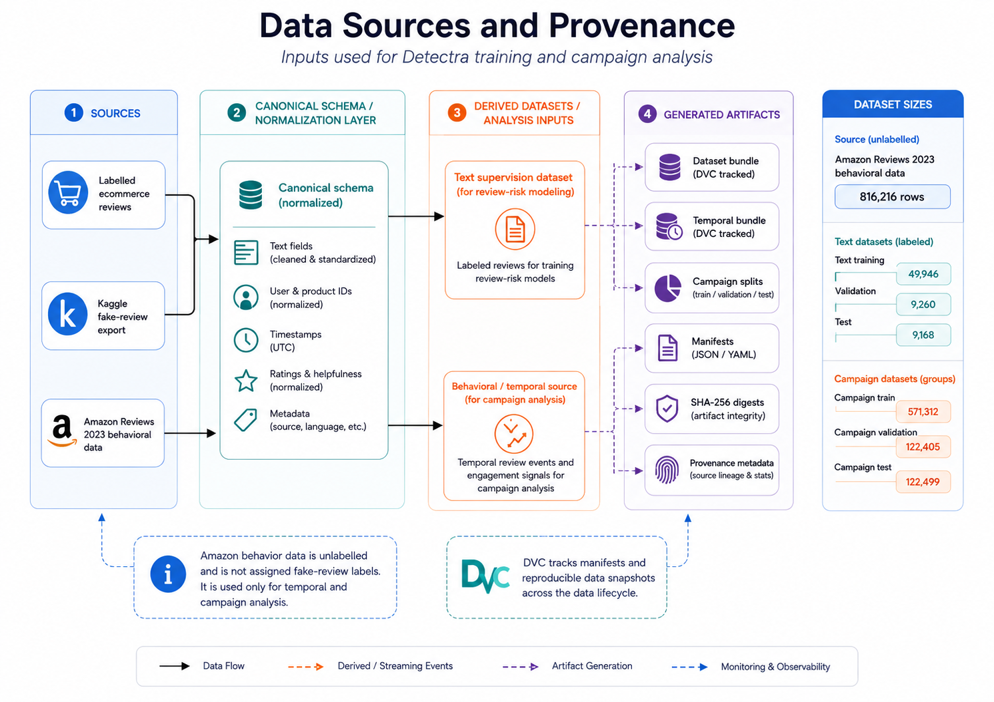
Data Versioning with DVC
Detectra guarantees exact reproducibility by separating the text supervision data from unlabelled behavioral data:
Data Snapshots: DVC hashes and tracks dataset states across the pipeline.
Remote Storage: Large artifacts are securely pushed to S3/MinIO.
Traceability: Every prediction can be traced back to its exact DVC manifest and Git commit.
Notes:
“Git versions code, Git LFS stores the promoted large model files, and DVC versions the data pipeline. DVC hashes raw inputs, commands, parameters and outputs in dvc.lock. If neither code nor input data changes, it can reuse the existing stage. If the data changes, dvc repro rebuilds the affected downstream stages. This gives us a reproducible connection from source data to processed bundles and training.”

Slide 6
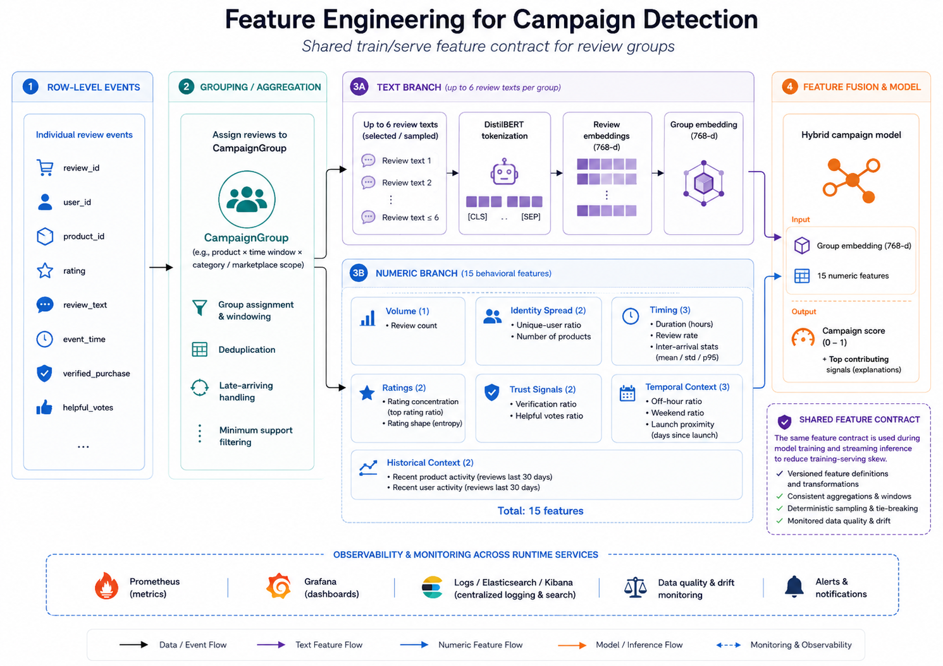
Campaign Feature Engineering
The campaign model relies on a hybrid architecture that evaluates both semantics and behavior:
Semantic Text Branch: Fine-tuned DistilBERT encodes textual similarity among grouped reviews.
Numeric Branch: 15 behavioral features track volume, temporal spacing, verification, and rating entropy.
Feature Fusion: Concatenates both branches to accurately classify coordinated abuse.
Notes:
“The campaign model is hybrid because text alone cannot prove coordination. Its semantic branch uses DistilBERT to represent what the reviews say. Its numeric branch processes fifteen behavioral and temporal features, such as review volume, timing gaps, rating entropy and verified-purchase behavior. The two representations are fused through neural layers to produce one campaign-risk probability. Reviews are grouped only when their product scope, time proximity and semantic relationship satisfy the graph rules.”

Slide 7
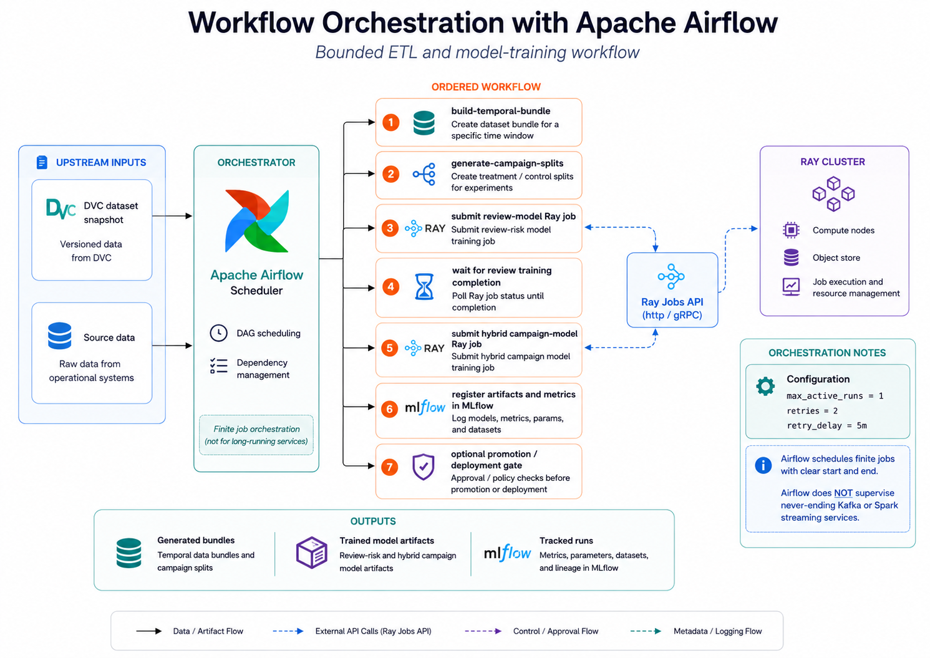
Workflow Orchestration
Apache Airflow serves as the primary scheduler for finite, bounded ML workloads:
Job Separation: Airflow manages task dependencies but offloads heavy compute to the Ray Cluster.
Ordered Execution: Sequences bundle creation, data splitting, and model training tasks.
Automated Tracking: Ensures successful jobs automatically log metrics and artifacts to MLflow.
Notes:
“Airflow is the conductor, not the heavy-compute engine. Its DAG first submits temporal data preparation to Ray and waits for completion. It then submits review-model training, waits again, and finally submits campaign-model training. PostgreSQL stores Airflow’s task and DAG state, while Ray performs the expensive work. The sensors use reschedule mode, so they release Airflow workers while waiting instead of wasting a worker slot.”

Slide 8
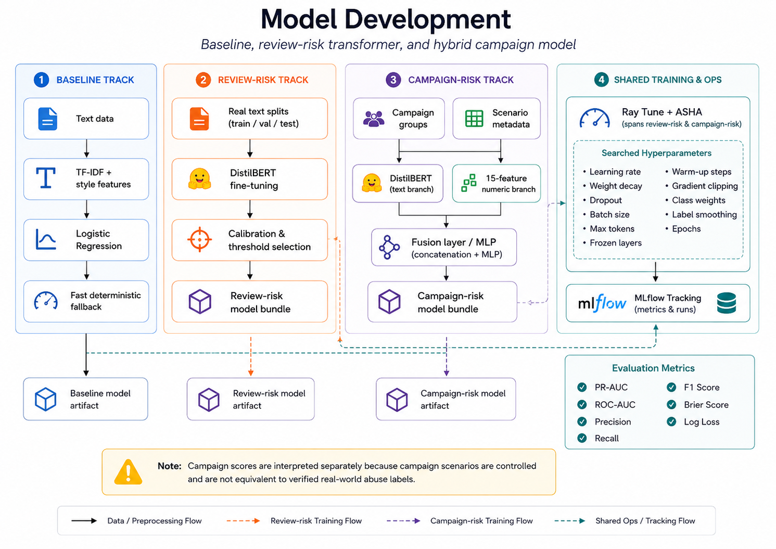
Model Development Tracks
Three parallel tracks ensure rigorous benchmarking and optimized inference:
Baseline: TF-IDF with Logistic Regression for fast, deterministic fallbacks.
Review-Risk: DistilBERT fine-tuned for individual review classification.
Campaign-Risk: The hybrid model trained via Ray Tune utilizing ASHA for early stopping.
Notes:
“We developed three model tracks. TF-IDF with logistic regression provides a fast, interpretable baseline. DistilBERT provides contextual individual review-risk predictions. The hybrid campaign model combines text with behavioral evidence for group-level detection. Ray Tune explores hyperparameters, and ASHA can stop weak configurations early when multiple trials and epochs are used. MLflow records each experiment and the selected model, while inference uses the promoted local model bundles.”

Slide 9
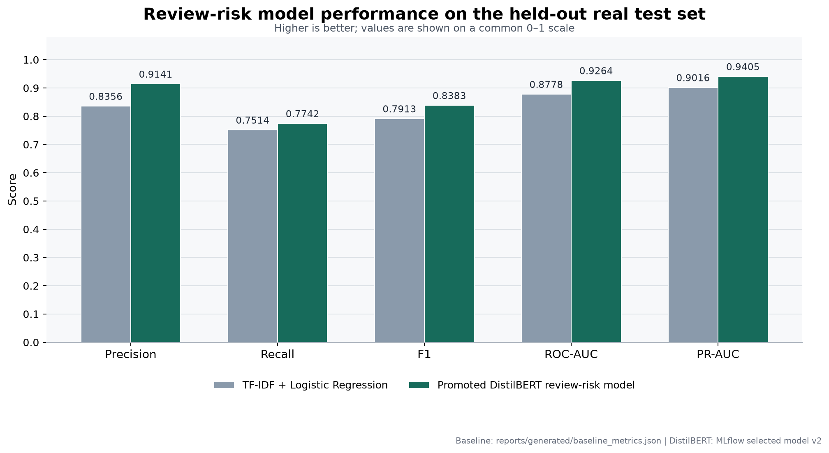
Model Performance Metrics
Validation results for the promoted DistilBERT Review-Risk model, optimized for minority-class screening rather than raw accuracy.
Notes:
“On the held-out real review test set, the promoted DistilBERT model outperformed the baseline across all five reported metrics. Precision increased from 83.56% to 91.41%, F1 from 79.13% to 83.83%, ROC-AUC from 87.78% to 92.64%, and PR-AUC from 90.16% to 94.05%. Recall improved more modestly, from 75.14% to 77.42%. PR-AUC is particularly important because this is a minority-class screening problem. These results show better ranking and fewer false accusations, while still requiring human review for consequential decisions.”

Slide 10
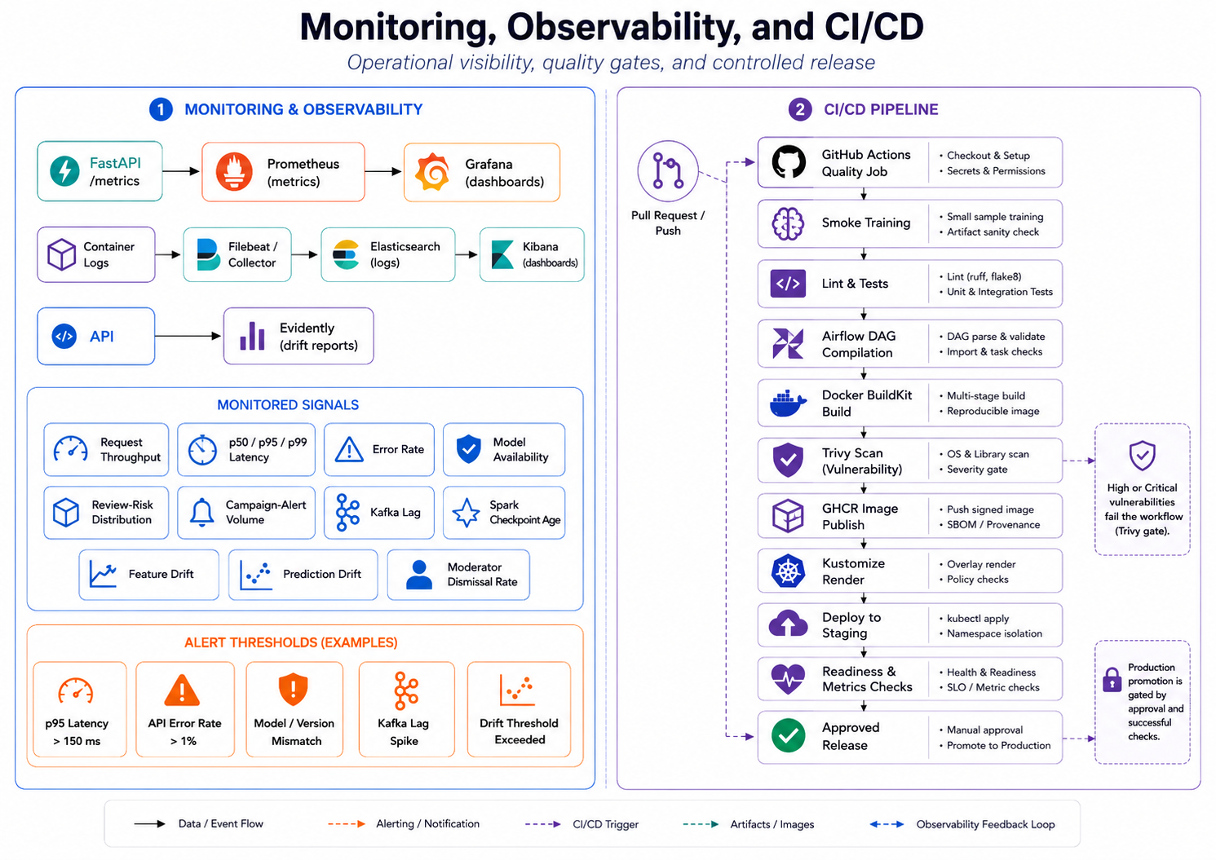
Monitoring , Logging & CI/CD
Continuous visibility and automated quality gates protect the production environment:
Observability: Prometheus scrapes API metrics; Grafana visualizes latency, drift, and throughput.
Centralized Logging: Filebeat ships container logs to Elasticsearch for Kibana querying.
Automated Pipelines: GitHub Actions enforces linting, testing, and Trivy vulnerability scans before GHCR publication.
Notes:
“A model is not production-ready merely because its notebook accuracy is good. We must know whether the API is healthy, whether requests are slow, whether streaming is failing and exactly what happened during an incident. Prometheus collects numeric API and Ray metrics, while Grafana turns them into operational dashboards. Filebeat collects container logs, Elasticsearch indexes them, and Kibana lets us investigate them with KQL. And finally we have deployed the code using GitHub Actions that tests the code, validates model bundles, builds Docker images and scans them with Trivy before publication. Detectra is therefore not only a model—it is a traceable, testable and observable decision system.”

Slide 11
Team Contributions
Chathura
Likhita
Karthik
DA25M558
[Roll No.]
[Roll No.]
All the Tech Stack
Model Training & Orchestration
Data Engineering & Streaming
UI API
Primarily DVC dataset and pipeline versioning
Prometheus metrics instrumentation
Grafana operational dashboards
Kibana / Elasticsearch centralised logging
GitHub Actions CI/CD pipeline
Entire tech Stack
MLflow experiment tracking and registry
Airflow DAG orchestration
Ray Tune hyperparameter optimisation
Model training and selection workflow
Apache Spark Structured Streaming
Apache Kafka event transport and topics
Data engineering, cleaning and canonical schema
Feature engineering and split generation

Slide 12
Questions?
Thank you for your time.
github.com/njchathura-boop/Bot-Review-Campaign
Notes:
“Detectra turns isolated review classification into a complete campaign-investigation workflow: reproducible data, two-level intelligence, streaming analysis, human control and operational evidence. Thank you—we welcome your questions.”

